Slide 1
The Transition from Dirty Fossil Fuels to a Cleaner Resilient Future
Susannah Diamond Transition Sheffield

Slide 2
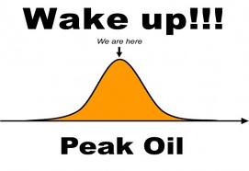
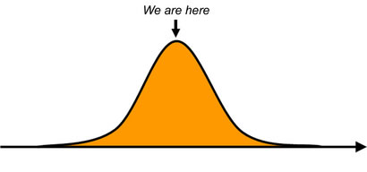
Peak energy

Slide 3
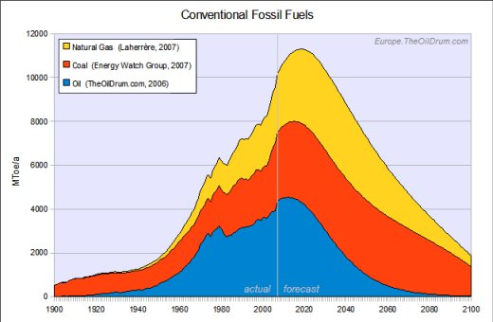

Slide 4
http://storyofstuff.org/movies by Annie Leonard

Slide 5
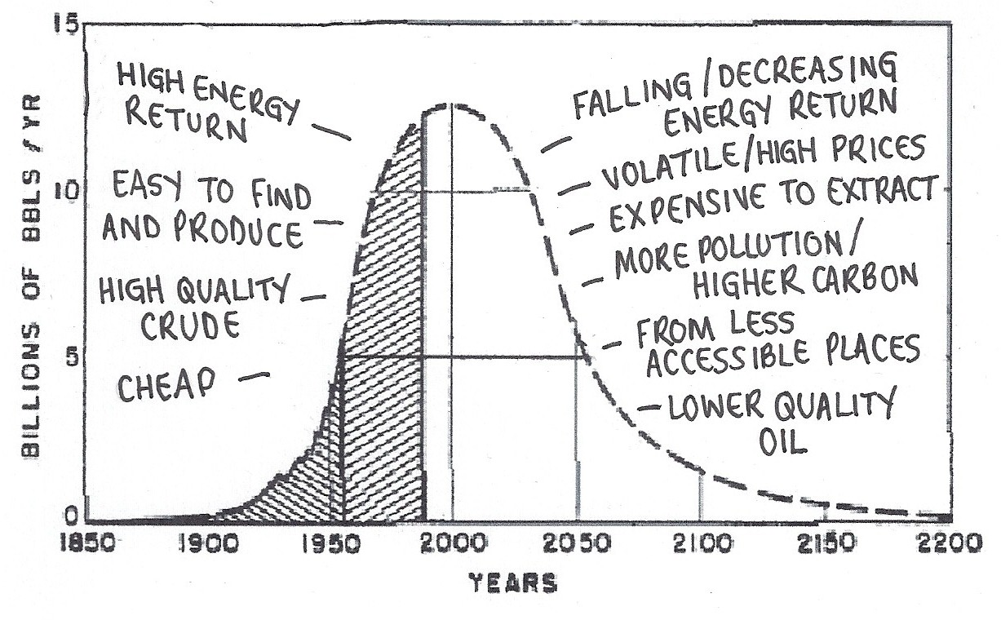
From Rob Hopkins' Transition Culture blog, 4 July 2012

Slide 6
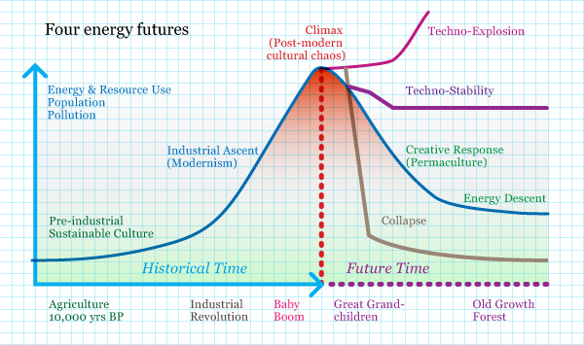
From 'Future Scenarios: How Communities can adapt to Peak Oil and Climate Change ' by David Holmgren

Slide 8
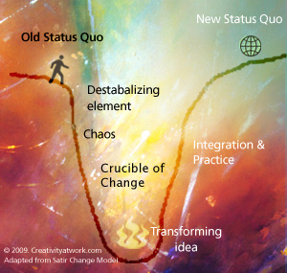
http://designtaxi.com/article/101726/Strategies-to-Help-You-During-Times-of-Transition/

Slide 9
http://nwcommunityenergy.org/biogeo/efficiency

Slide 10
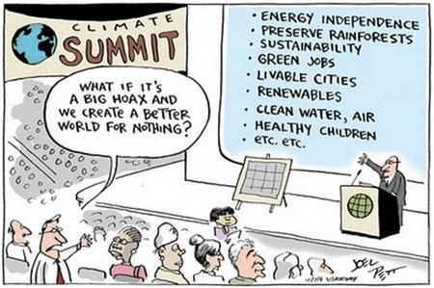
Cartoon by Joel Pett

Slide 11
Susannah Diamond Transition Sheffield
susannah@transitionsheffield.org.uk
@transitionsheff

